Slide 1





Re-loan limit
Yoel Kortick. Senior Librarian
https://www.askideas.com/20-amazing-sunset-view-pictures-and-images-of-charles-bridge/

Slide 2
Re-loan limit
It is possible to configure a re-loan limit, preventing patrons from re-loaning items that they have just returned.
This is included in a new policy type called “Reloan Limit”.
A different copy of the same title with the same material type is considered as a single item for this policy.

Slide 3
Re-loan limit
The policy type has three possible options:
None – There is no limit on borrowing copies of the same title. This is the prior functionality and the default.
Parallel – The patron may not check out two copies of the title at one time.
Other – You may define the time span (in the Unit of Measurement) in which the same item may not be re-loaned - minutes, hours, days, weeks, or months.

Slide 4
Re-loan limit
When the re-loan limit policy is set to Parallel and an item of the same title and material type is attempted to be loaned to the same patron, the following block message is displayed: Item of the same title is already on loan for this patron. Parallel loan is prohibited.
When the re-loan limit policy is set to Other and is within the specified period, the following block message is displayed: An item of the same title was recently loaned to this patron.

Slide 5
Re-loan limit
Both blocks have a corresponding block in the Block Preferences table.
For serial items, the limit only applies to items with the same description.
If the policy is set to none or the time frame for re-loaning has passed, the loan will successfully execute. See Loaning Items.

Slide 6
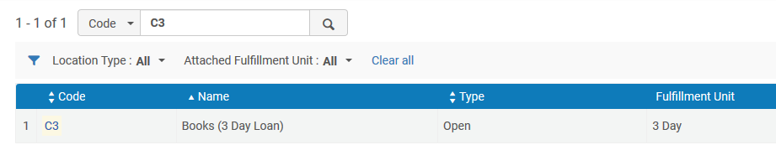
Re-loan limit
For example … in Central Library location “Books (3 day loan)” uses fulfillment unit “3 Day”

Slide 7
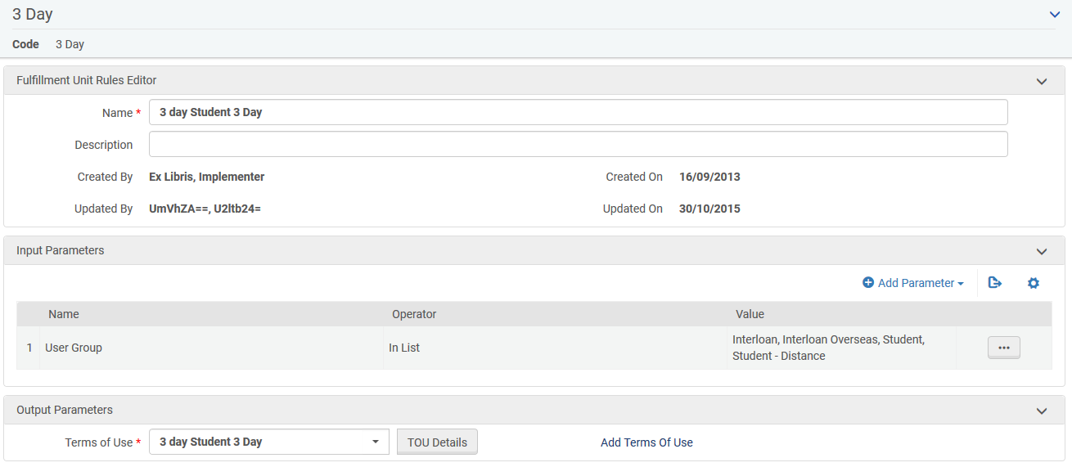
Re-loan limit
Fulfillment unit “3 Day” has a rule that states “If the user group = student then use terms of use “3 day student 3 day”

Slide 8
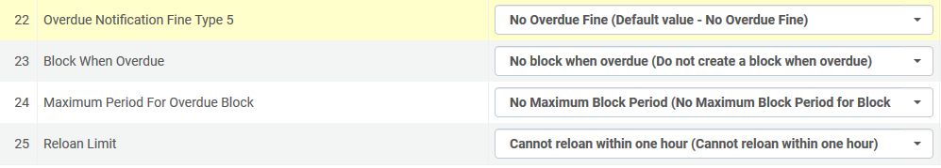
Re-loan limit
terms of use “3 day student 3 day” has reloan limit “Cannot reloan within one hour”

Slide 9
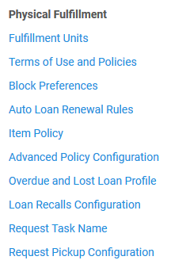
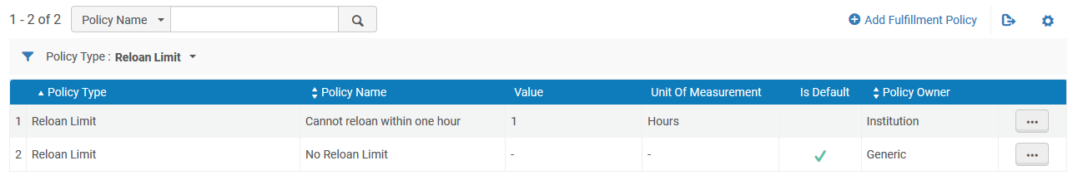
Re-loan limit
Let’s now look at reloan limit “Cannot reloan within one hour”

Slide 10
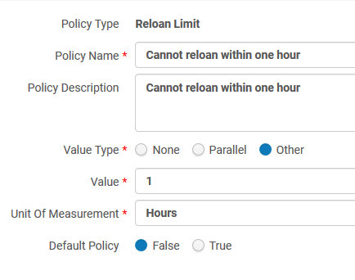
Re-loan limit
Here is reloan limit “Cannot reloan within one hour”
Patron cannot reloan the item a 2nd time within one hour after loaning it the first time.

Slide 11
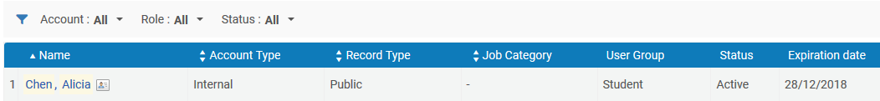
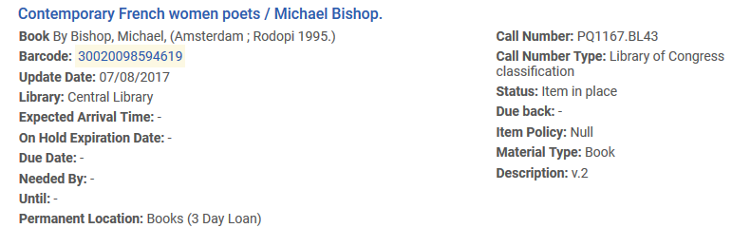
Re-loan limit
Patron Alicia Chen is a student
Item barcode 30020098594619 for title “Contemporary French women poets” is in location “Books (3 Day Loan)”

Slide 12
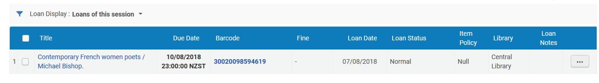
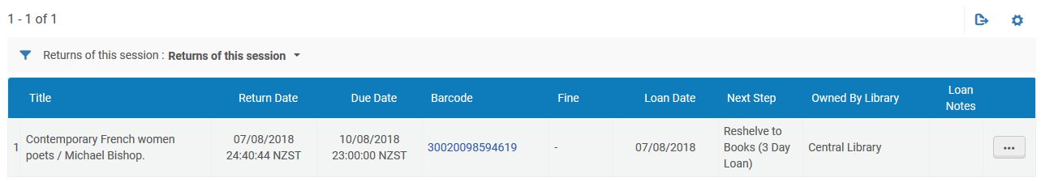
Re-loan limit
Patron Alicia Chen loans item 30020098594619
Patron Alicia Chen returns item 30020098594619

Slide 13
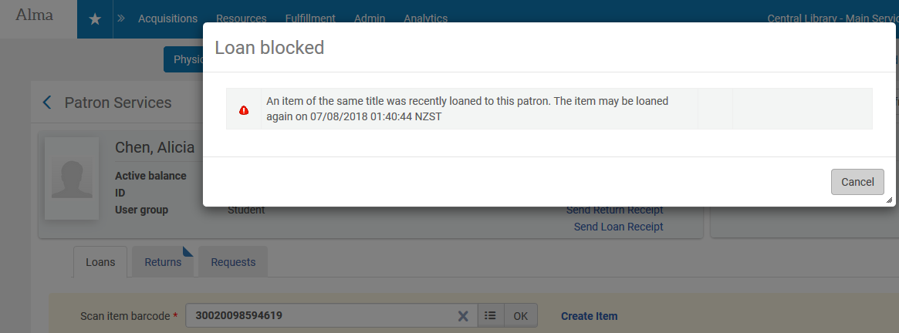
Re-loan limit
Patron Alicia Chen tries to loan item 30020098594619 again within one hour of when she first loaned it and this happens:

Slide 14
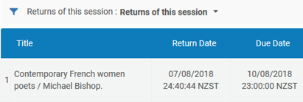
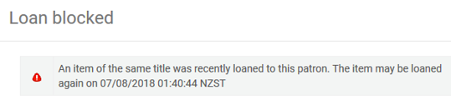
Re-loan limit
In the previous example we saw that the item can be reloaned only one hour after it was returned.
Patron returned item at 24:40:44. Message states that patron can reloan it at 01:40:44

Slide 15
Thank You
Yoel.Kortick@exlibrisgroup.com
https://www.askideas.com/20-amazing-sunset-view-pictures-and-images-of-charles-bridge/

